Slide 1
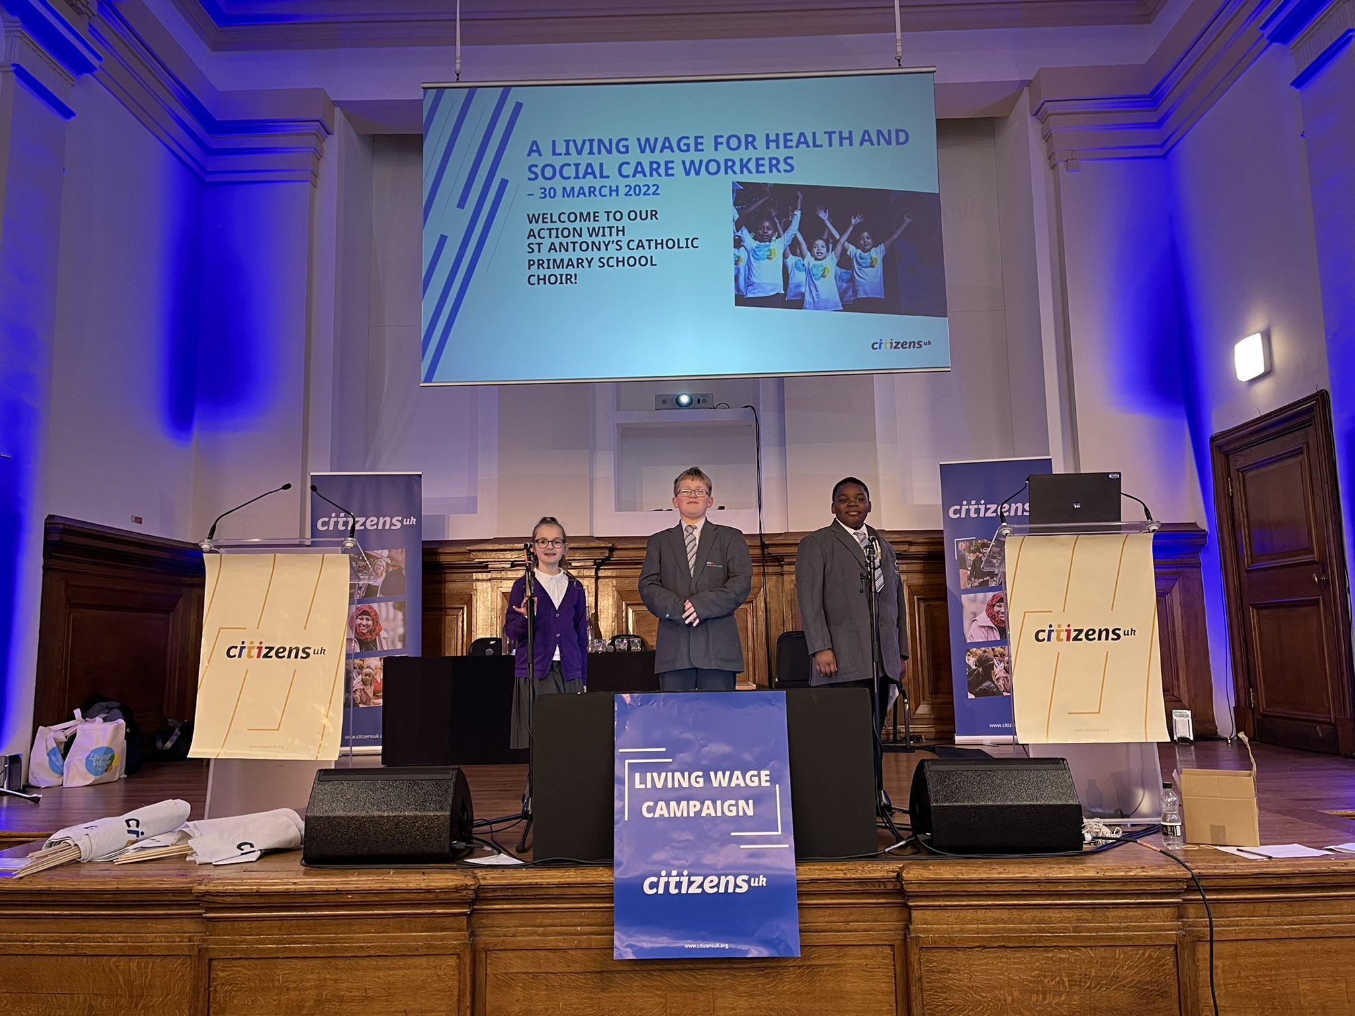
The Living Wage Campaign
“More important than ever”
A resource for youth groups

Slide 2
What’s the story of the Living Wage Campaign? https://youtu.be/VHB8lNf6k0A

Slide 3
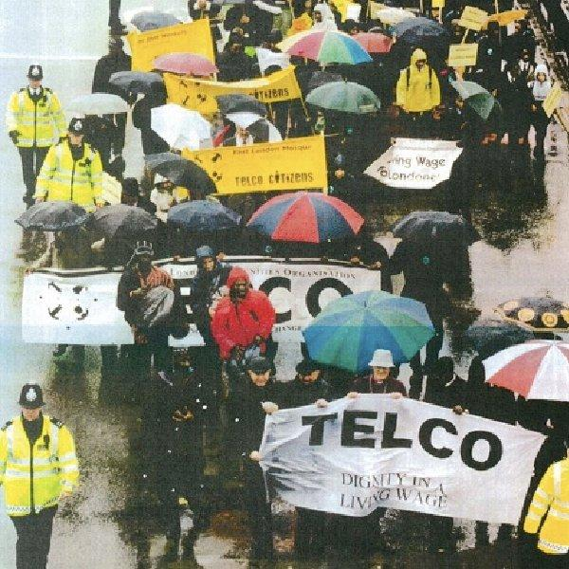
It all started over 20 years ago in East London…
The Living Wage Campaign was started by leaders in East London.
It was a student at St. Bonaventure’s who had written in his school book that his mother had died. Upon investigation, it turned out she was earning such low wages and working incredibly long hours, that she was barely home to see her son. She was the cleaner in the office of one of the senior executives at HSBC; the lowest earner working for one of the highest earners.
This story was behind the inspiration for teachers and faith leaders to launch the Living Wage Campaign. They decided that it was time for local people to act and so they began to organise for a real Living Wage.

Slide 4
Why does the
Living Wage matter?
Lynn’s story https://www.youtube.com/watch?v=j-f11bTbzA8
With the cost-of-living crisis deepening, the campaign
for a real Living Wage is more important than ever.

Slide 5
We appreciate the Thursday night clapping, but I feel like a Roman Gladiator going into the ring.
Everyone is clapping you, but you’re pitting yourself against a deadly disease without the proper pay and protection. That’s why I’ve launched this petition to ask Matt Hancock MP to properly fund social care so staff like me and many others can receive the real Living Wage.
TABITHA
Care Worker

Slide 6
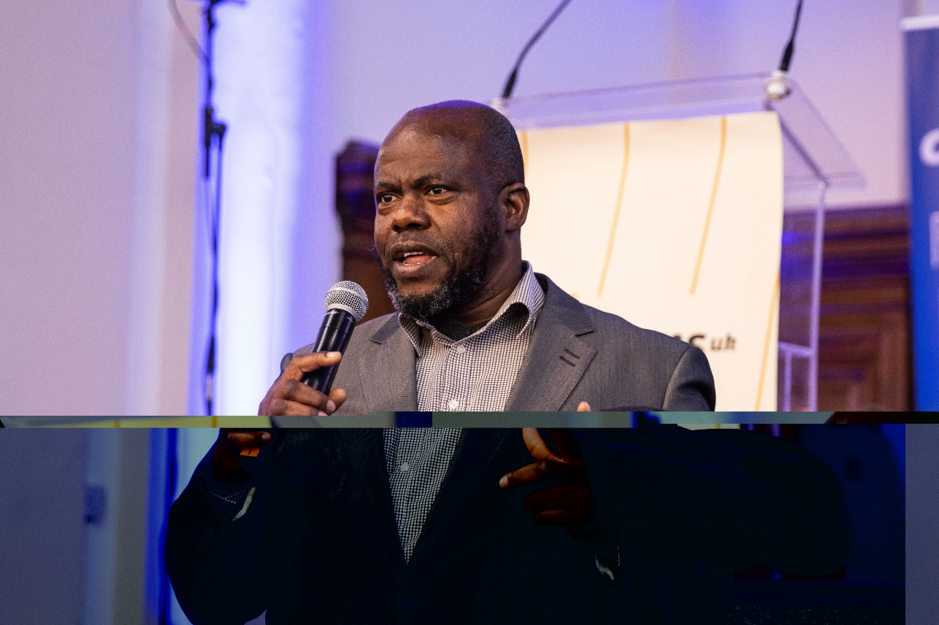
I joined in this fight today, to be a voice to those that are choking and suffering in silence. Many care workers can't pay their bills or put food on the table because health and social care is regarded as unskilled labour. The government must listen. We are not unskilled, and we need a real living wage
FREDLYNE EVBOUMWAN,
Nottingham Citizens leader and home care worker, speaking at the Citizens UK Living Wage for Social Care Assembly on March 30th 2022.

Slide 7
DISCUSSION
Turn to the person next to you and share with them…
Why you think it’s important for
workers to earn enough
money to live on?

Slide 8
So What is the Real Living Wage?
The Living Wage is an hourly rate, calculated according to cost of living in the UK by the Living Wage Foundation. The UK Living Wage is currently £10.90 per hour. The London Living Wage is currently £11.95 per hour.
In April 2016, the government introduced a higher minimum wage rate for all staff over 25 years of age inspired by the Living Wage campaign - even calling it the ‘National Living Wage’.
However, this wage is not calculated according to what employees and their families need to live. Instead, it is based on the governments standard. The government minimum takes into account what is affordable for businesses, but is not based on not what it actually costs to live.
The real Living Wage is calculated on the cost of a basket of supermarket shopping.

Slide 9
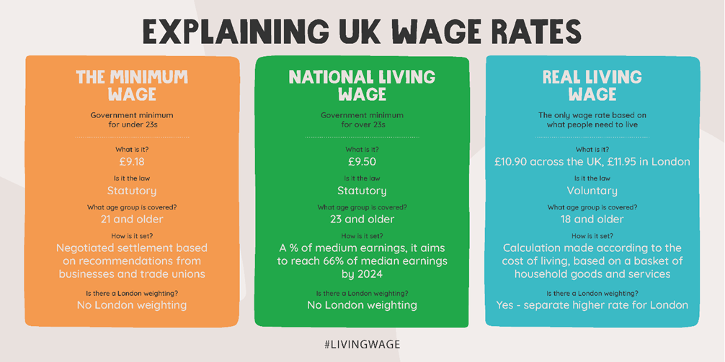
Explaining UK Wage Rates

Slide 10
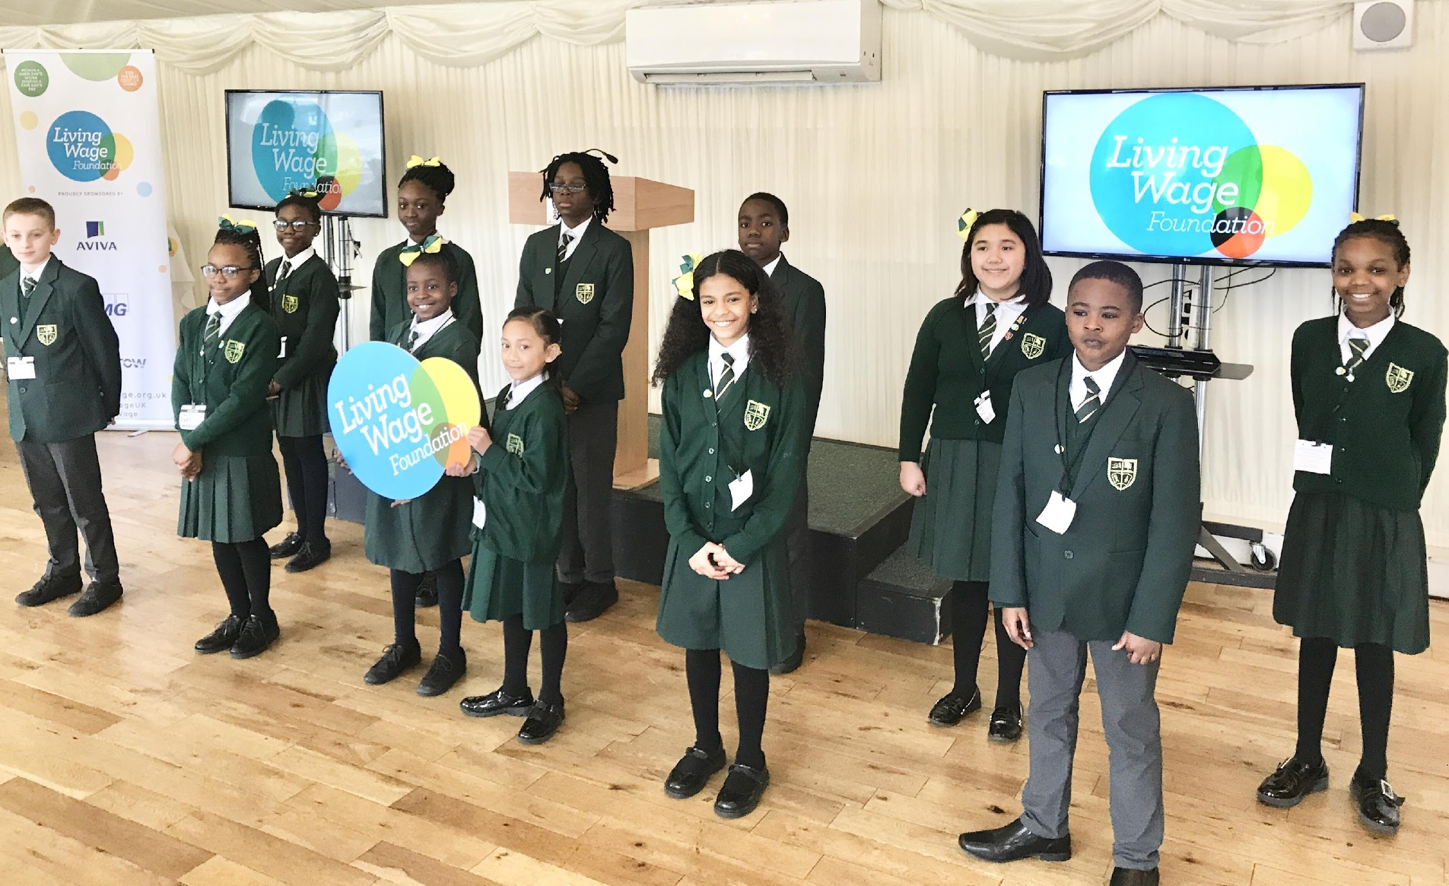
YOUNG PEOPLE LEADING THE WAY: The story of St.Antony’s students

Slide 11
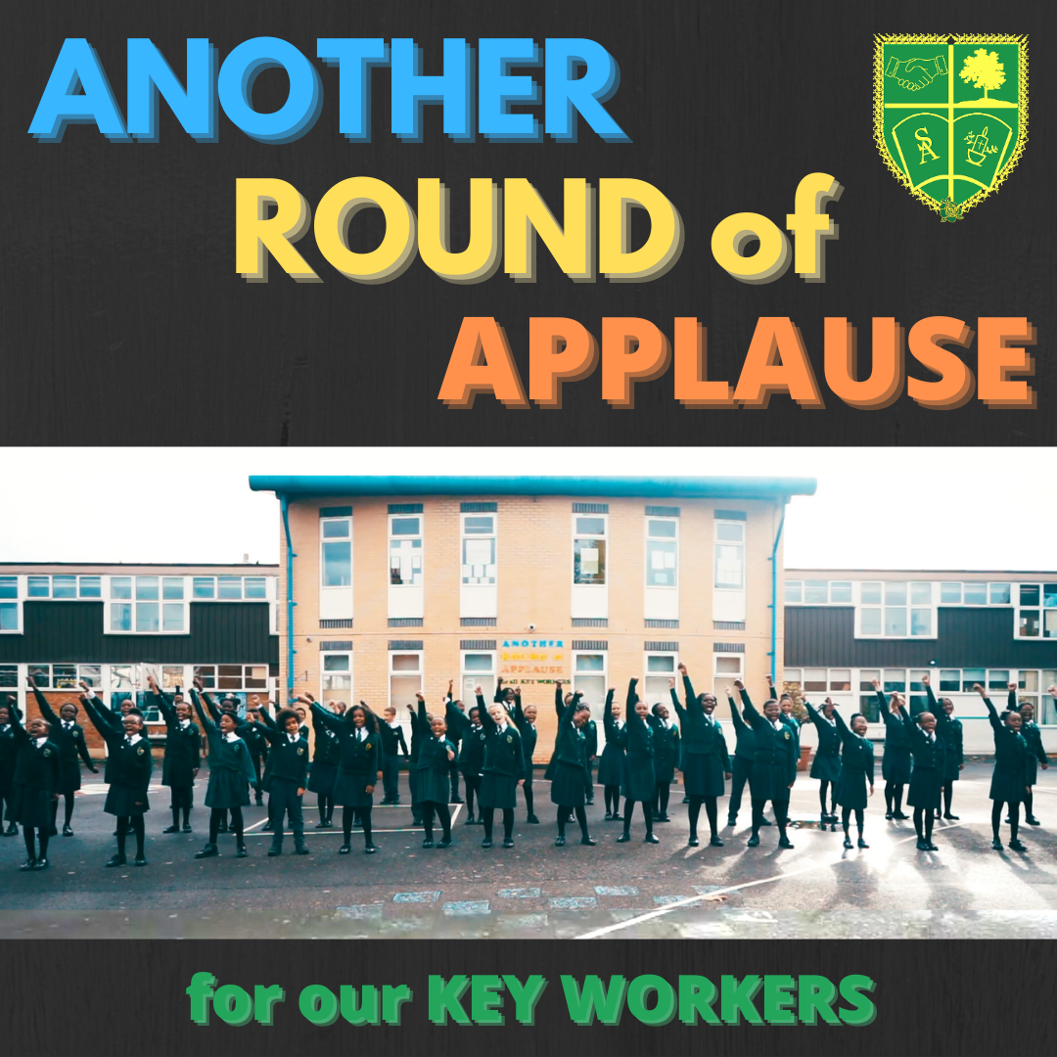
YOUNG PEOPLE LEADING THE WAY: The story of St.Antony’s students
In light of the COVID-19 crisis, St Anthony’s students wrote a song in response to the Thursday night clapping and to celebrate the role that key workers have played during the pandemic.
https://youtu.be/Phn5w1OlFDs
The song was premiered at the annual London Living Wage Week, November 2020

Slide 12
GROUP DISCUSSION
Q. What line from the song jumped out to you? Why? Q. Think about someone you know who is affected by low wages – what is their experience? Q. How might that person benefit from receiving a Living Wage? Q. Do you think its important to talk about / build awareness around the Living Wage?
ACTIVITY
Could you write and create your own song/poem about the cost of living crisis/the Living Wage and share on social media?

Slide 13
HOW ELSE CAN OUR YOUTH GROUP
GET INVOLVED?
With the cost-of-living crisis deepening, the campaign for a real Living Wage is more important than ever.
Do you know people affected by low pay in your wider school community? Could you speak to them about their experiences?
Would you, or they like to get involved with action and activity organised by your local Citizens UK chapter around this campaign?

